Slide 1











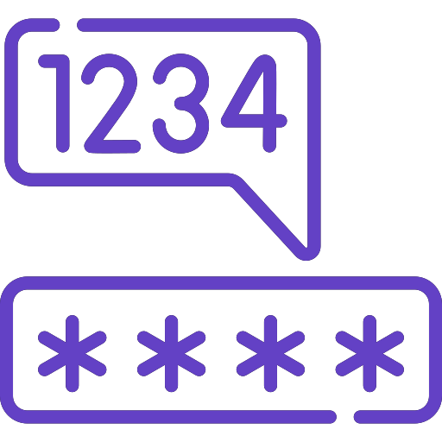
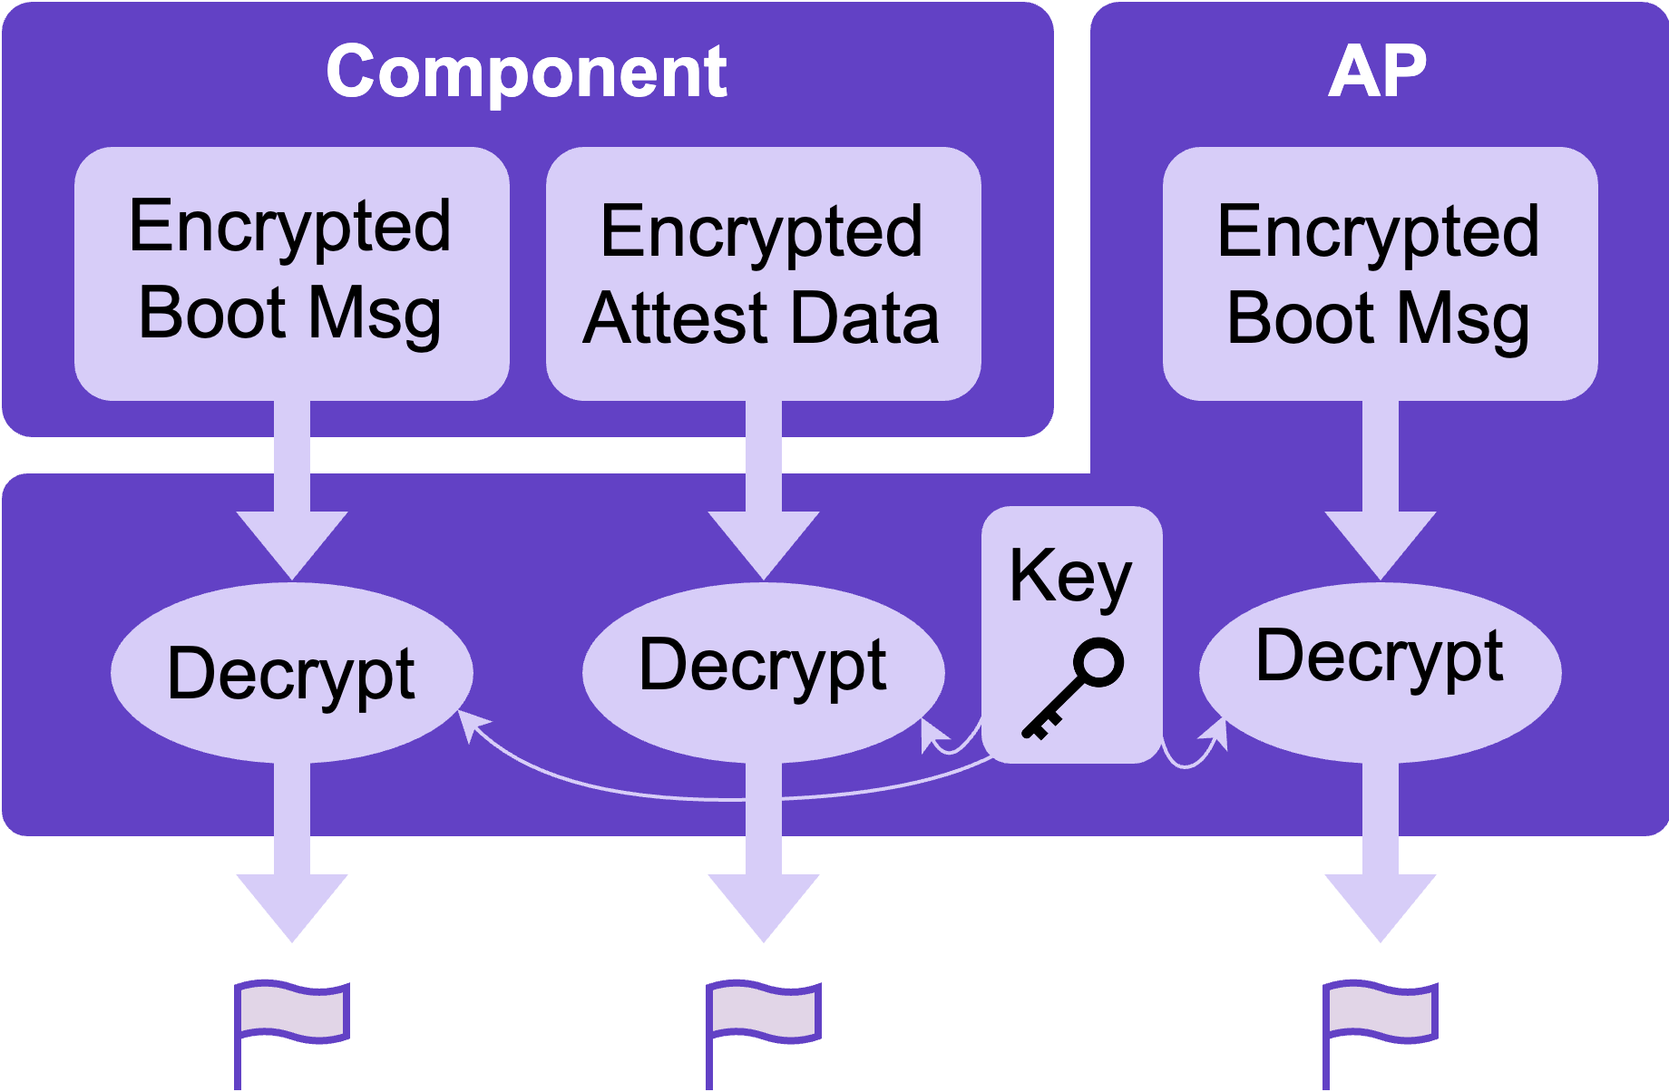
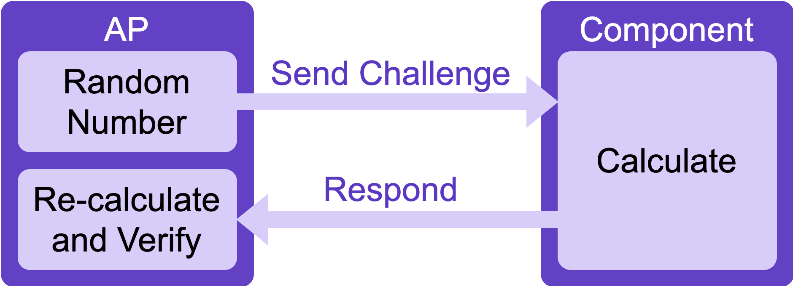
Team Cacti
University at Buffalo
Gaoxiang Liu, Zheyuan Ma, Alex Eastman, Xi Tan, MD Armanuzzaman,
Sagar Mohan, Afton Spiegel, and Sai Bhargav Menta
Advised by: Prof. Ziming Zhao and Prof. Hongxin Hu
Design Overview
Attest
The AP signs a component's random number and sends back the signature for validation. After validation, the component sends encrypted attestation data to the AP for decryption.
Boot
The AP verifies each component by having it sign a random number; the components then validate the AP similarly. On successful validation, both the AP and components boot up.
Post-Boot Communication
To ensure message integrity, messages are signed with the slave device’s I²C address, and a random number provided by the recipient. If the recipient can verify the signature, it trusts the data.
PIN and Token Checking
We only store the Argon2 keyed-hash values of the PIN and token. User input is also hashed, and a constant-time comparator is used to verify hash values.
Secrets | Key1_Public | Key1_Private | Key2_Public | Key2_Private | AEAD Key | Hash Key & Salt
Stored at | AP | Component | Component | AP | AP | AP
Description | Create signature for AP’s message | Validate signature for AP’s message | Create signature for AP’s message | Validate signature for AP’s message | Decrypt the attestation data and boot message | Secure attestation PIN and replace token
Defensive Highlight
Offensive Highlight
Encrypted Sensitive Data
Flags in the boot message and attestation data are encrypted and stored securely
Only the AP holds the decryption key
Even if attackers can read a component's flash memory and SRAM, the flags remain secure
Memory Wiping
After using sensitive data like keys, fill the memory location with zeros to securely erase it
Mitigating Bruce-Force Attacks
Use the Argon2 keyed-hash algorithm for the inputted PIN and Token; this method is intentionally slow
Introduce a deliberate delay during the checking
Longer delay after a failed attempt, the delay is still in effective even resetting the board
A longer delay after a failed PIN or Token attempt, which remains effective even after resetting the board
Mitigating Fault-Injection Attacks
Introduce random delays of several hundred CPU cycles
Execute important conditional expression twice; for
example, branching on authentication or password validity
Attacks
Brute-Force Try all possible PIN codes
Shared Secrets Reuse known keys between deployments
Replay Attack Capture and replay authentic messages
Predictable Keys Key value is 0 due to global variables
Exploiting Weak Validation Designs
If a post-boot communication message has a fixed checksum for the same message, it can be captured and replayed, allowing the checksum validation to still succeed.
Many teams use pre-boot validation to confirm the authenticity of the AP and components by sending a fixed secret value. However, this value can be intercepted during communication or extracted by malicious firmware, leading to a security breach as the secret is exposed.
How to Fix It
Ensure that the checksum for a message is unique each time, even if the message itself is unchanged
Do not reuse the same secret for different validation processes
Ensure that any random number used in the validation process is unpredictable to enhance security
Use the challenge-response mechanism to authenticate, rather than using a fixed value (See the figure below, where the AP tries to authenticate the component)
The research of Team Cacti is supported in part by a National Centers of Academic Excellence in Cybersecurity grant (H98230-22-1-0307).

